Slide 1
WELCOME…
ENHANCING ORIO’S MANAGEMENT SYSTEM (POS )

Slide 2
GROUP MEMBERS (09)
0055 Dhanuska
0030 Ihshana
0013 Hathika
0080 Kavin priya
0052 Dhanushi
0100 Zainab.

Slide 3
INTRODUCTION
Welcome everyone, and thank you for joining us today. Our project focuses on developing a Point of Sale (POS) system for a local ice cream shop, a client that has traditionally recorded their daily transactions in a book. Recognizing the limitations of manual record-keeping, our goal is to modernize and streamline their sales process by moving it to a digital platform. Our team of six has begun this journey by creating the foundational forms using the Java programming language, setting the stage for a comprehensive PoS system that meets our client's needs.

Slide 4
CLIENT REQUIREMENTS
Our client's main requirement was clear: transform the manual, time-consuming process of recording sales data into an efficient, computerized system. They needed a solution that could not only track sales, inventory, and customer information in real time but also be user-friendly for their employees. Additionally, the ability to generate reports easily and accurately was a key demand, aiming to improve business decisions and growth strategies.

Slide 5
OBJECTIVES & SOLUTIONS
To address our client's needs, our objectives were straightforward. First, develop an intuitive interface for the (POS) system, ensuring ease of use for all employees. Second, implement a robust database that securely stores all transactional and inventory data, enabling real-time updates and insights. Third, include functionality for generating detailed sales reports, aiding in better business analysis and decision-making. By focusing on these objectives, our solution aims to significantly reduce manual errors, save time, and provide a scalable platform as the business grows.

Slide 6
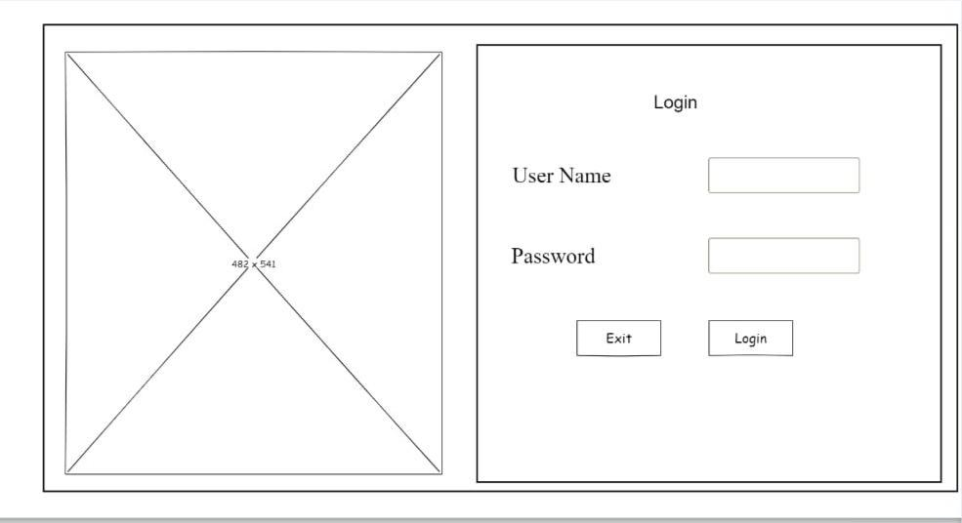
Wireframes login

Slide 7
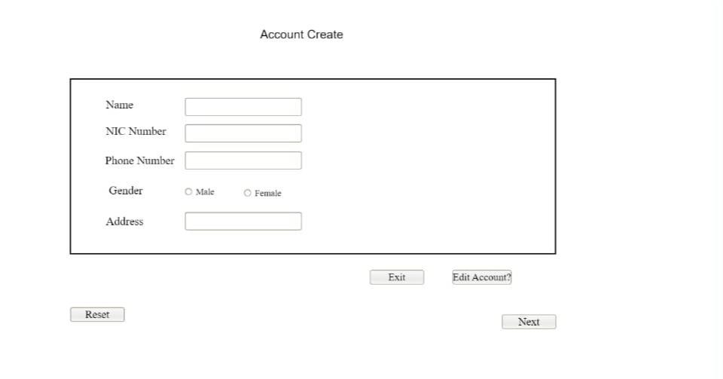

Slide 8
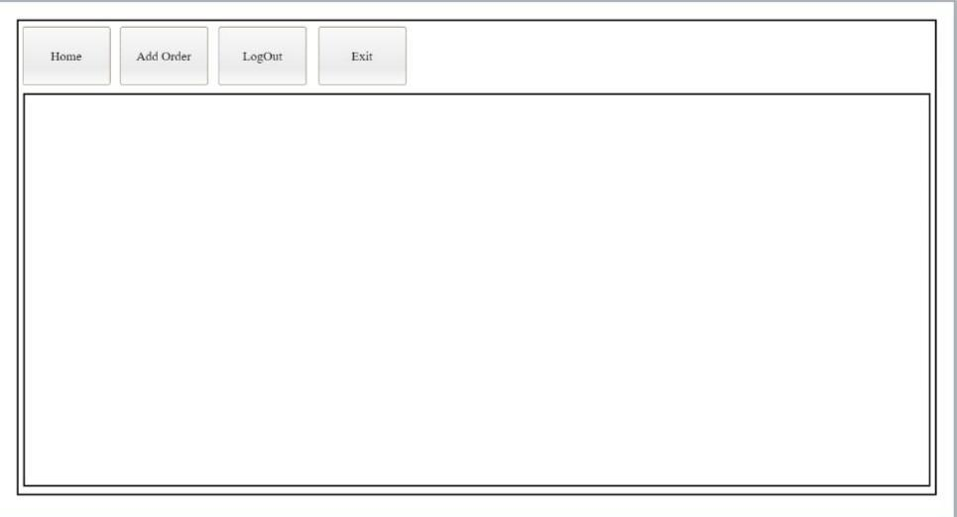

Slide 9
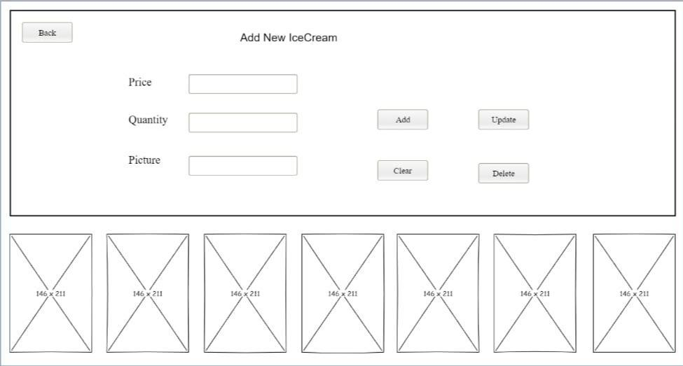

Slide 10
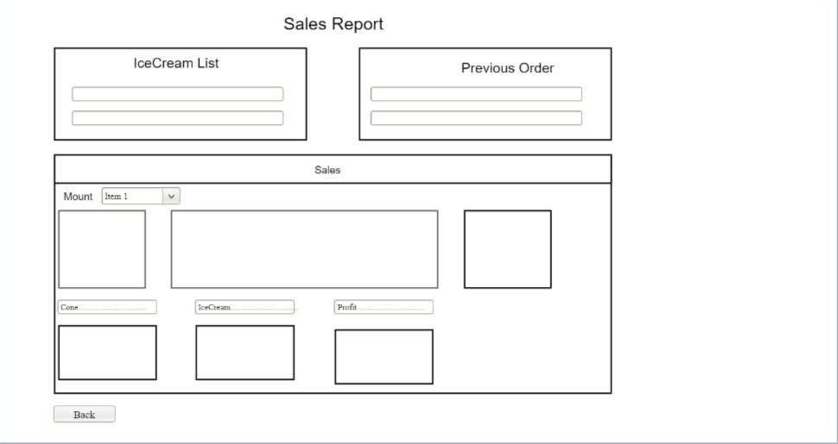

Slide 11
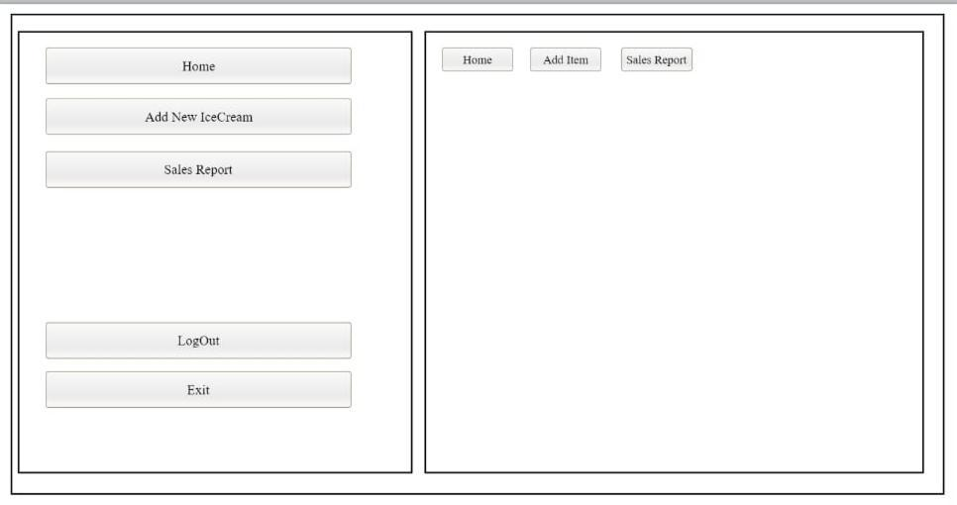

Slide 12
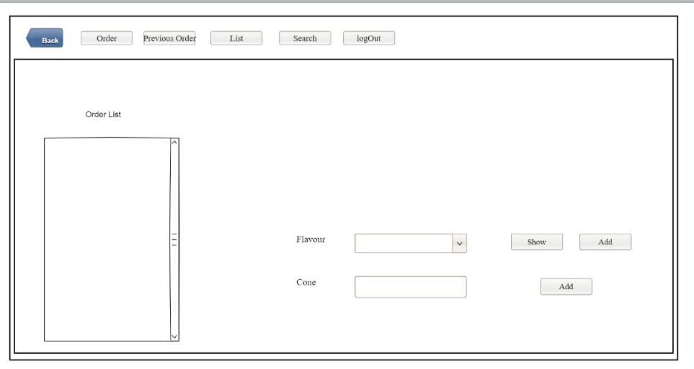

Slide 13
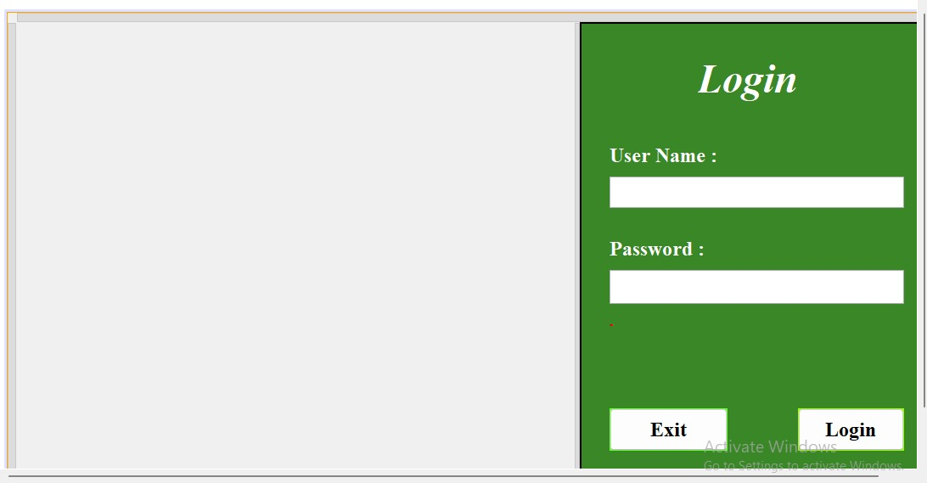
Login Form

Slide 14
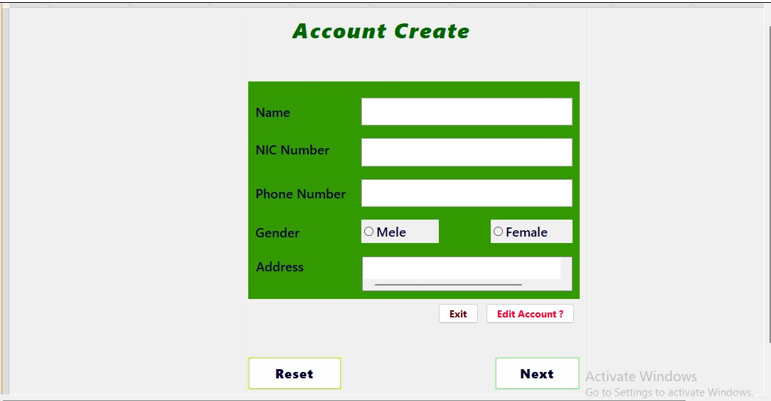
Account create form

Slide 15
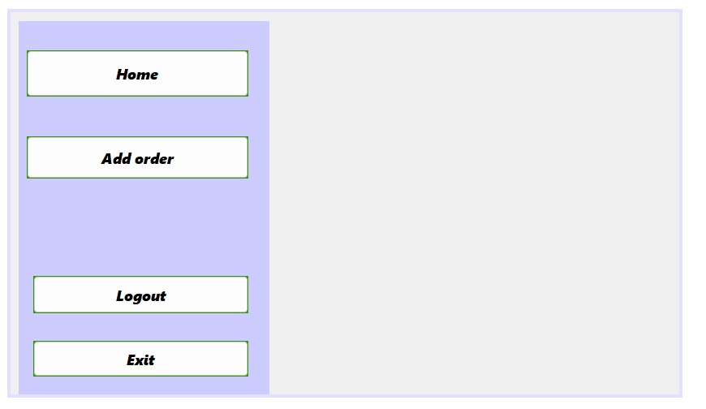
User menu form

Slide 16
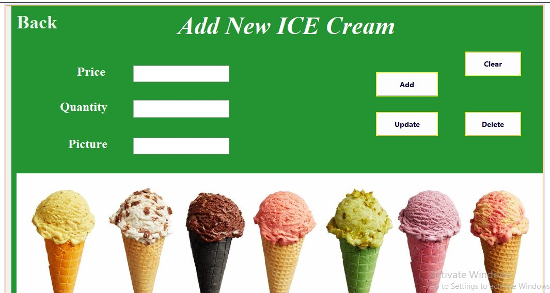
New ice cream Add form

Slide 17
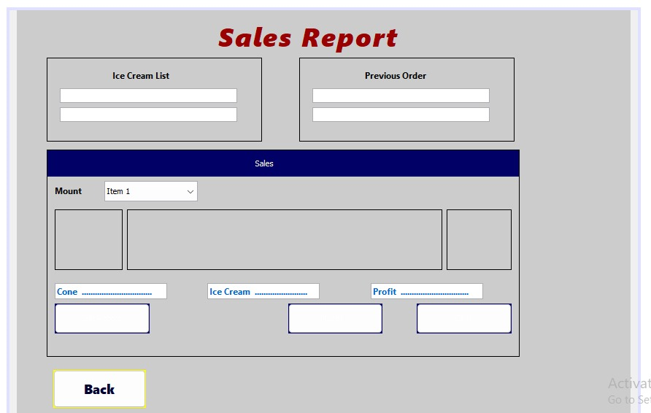
Sales report form

Slide 18
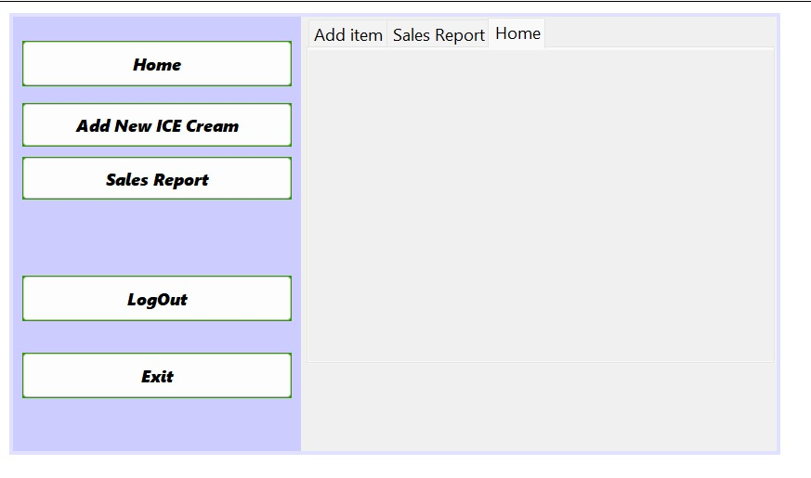
Admin menu Form

Slide 19
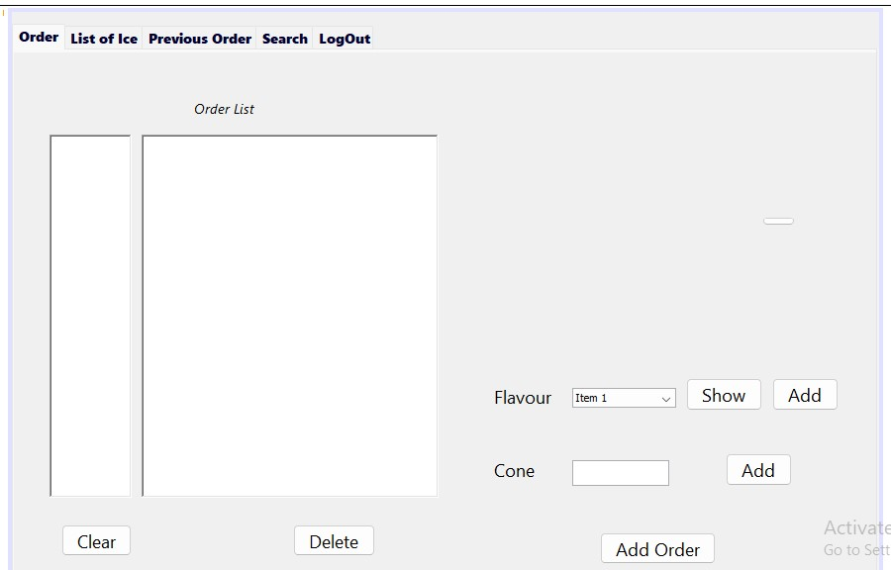
Order Form

Slide 20
ENDING & THANKING
In conclusion,
our project represents a significant leap towards modernizing the operations of our client's ice cream shop. By transitioning from manual bookkeeping to a digital POS system, we are not only enhancing the efficiency of daily transactions but also paving the way for more informed business strategies. We'd like to extend our deepest gratitude to our client for entrusting us with this project, and to everyone who has supported us throughout this journey. Thank you for the opportunity to make a difference.

Slide 21
THANK YOU!!!

